Slide 1
Acids and Bases
Ionization of Water
Types of Acids
Indicators
Titration

Slide 2
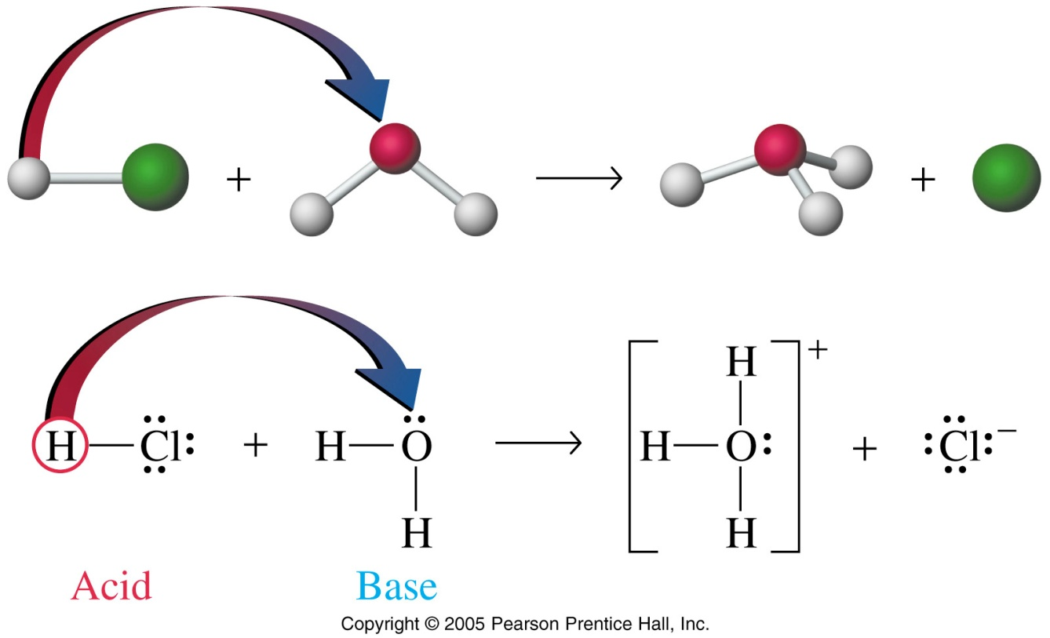
The Brønsted–Lowry Theory
According to this theory, an acid is a proton donor and a base is a proton acceptor

Slide 3
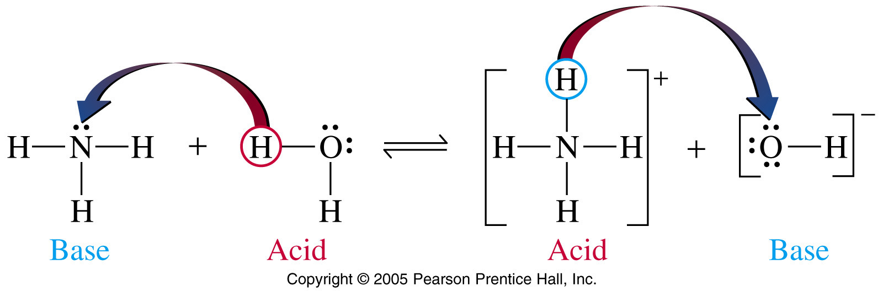
Conjugate Acids and Bases
The conjugate acid of a base is the base plus the attached proton and the conjugate base of an acid is the acid minus the proton

Slide 4
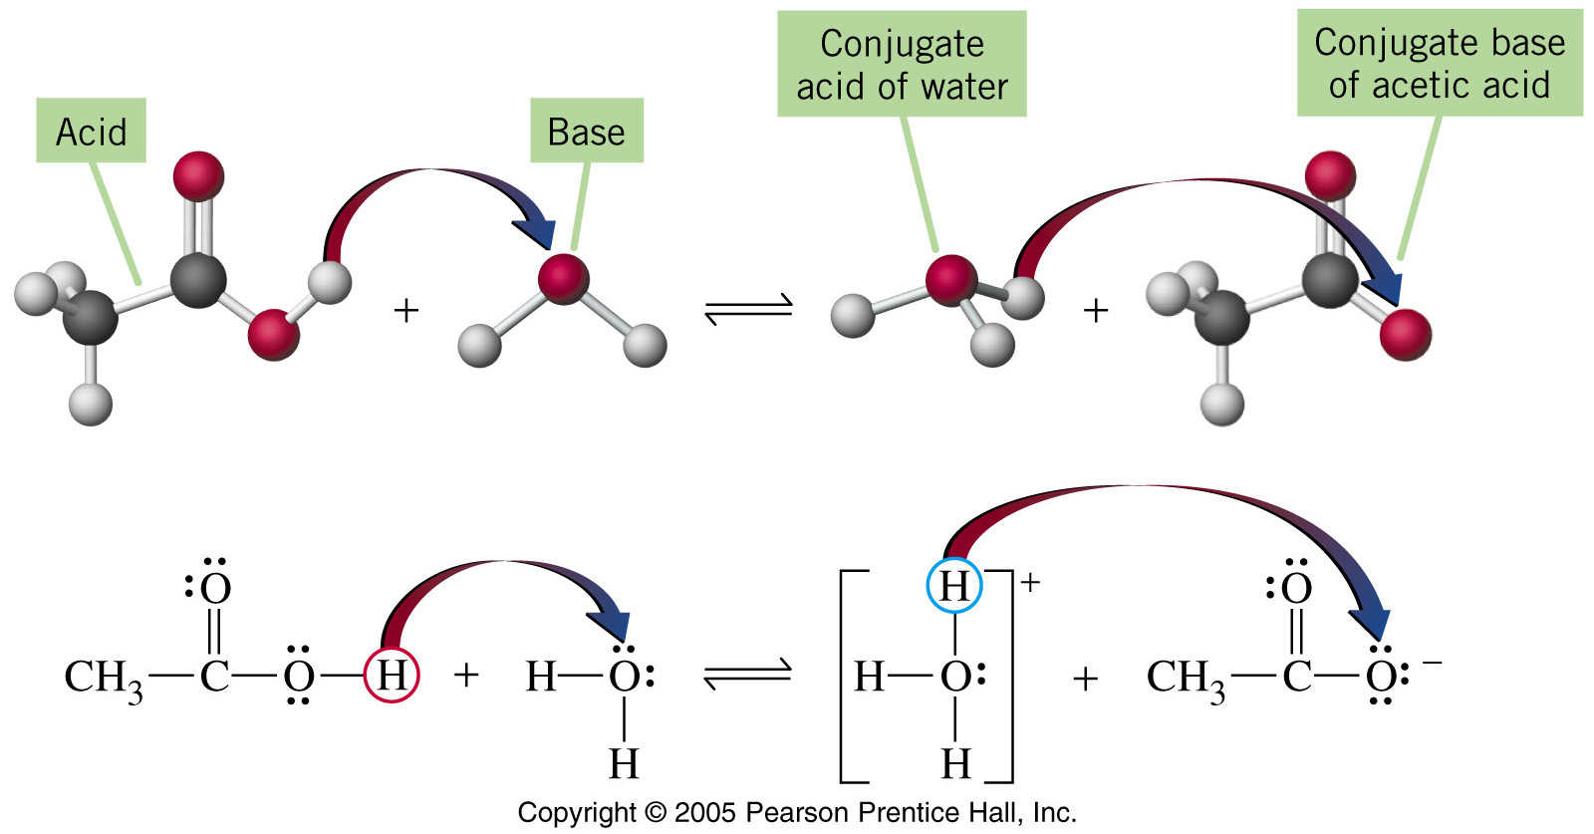
Weak Acids and Bases
For weak acids and bases, equations can be written to describe equilibrium conditions

Slide 5
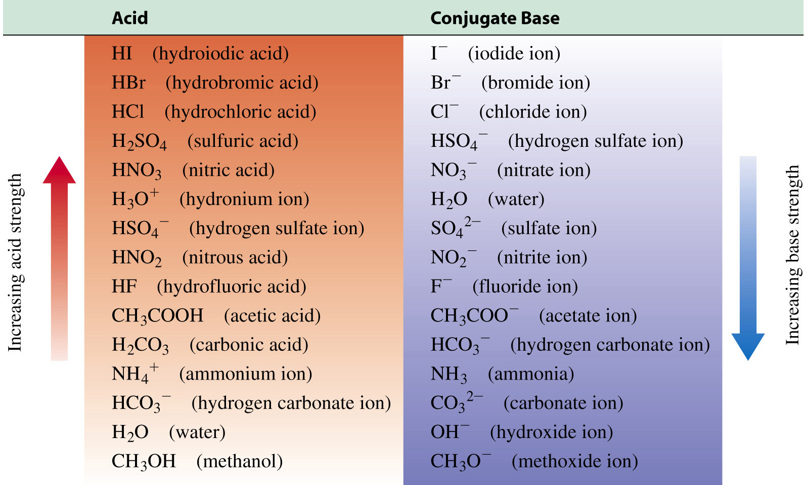
Strengths of Conjugate Acid–Base Pairs

Slide 6
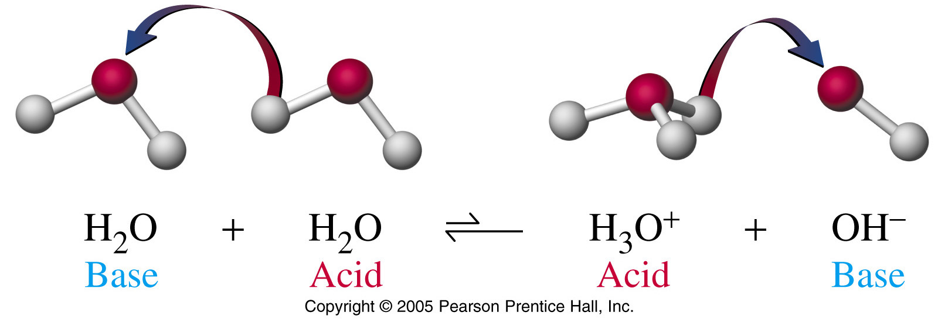
Self-Ionization of Water
Water is a weak electrolyte and self-ionises, that is, it creates a small amount of H₃O⁺ and OH–
In the ionisation of water, equilibrium strongly favours the reactants.
The equilibrium constant for this process is called the ion product of water and is represented by the symbol K_{w.}

Slide 7
Self-Ionization of Water
K_{w =} [H+] [OH-]for water is calculated to be 1.0 × 10^{–14} M (at 25 ºC)
This means that in any aqueous solution at 25 ºC the product of the hydrogen ion and hydroxide ion concentrations is always 1.0 × 10^{–14.}
This equilibrium constant is very important because it applies to all aqueous solutions—acids, bases, salts, and nonelectrolytes—not just to pure water

Slide 8
Self-Ionisation of Water
In pure water or any neutral solution:
[H+]=[OH-]= 1.0x10^{–7} mol L-1
In acidic solutions the [H+] is greater than 1.0x10^{–7} mol L-1 and the [OH-] is less than 1.0x10^{–7} mol L-1.
Conversely, in a basic solution the [H+] is less than 1.0x10^{–7} mol L-1 and the [OH-] is greater than 1.0x10^{–7} mol L-1.

Slide 9
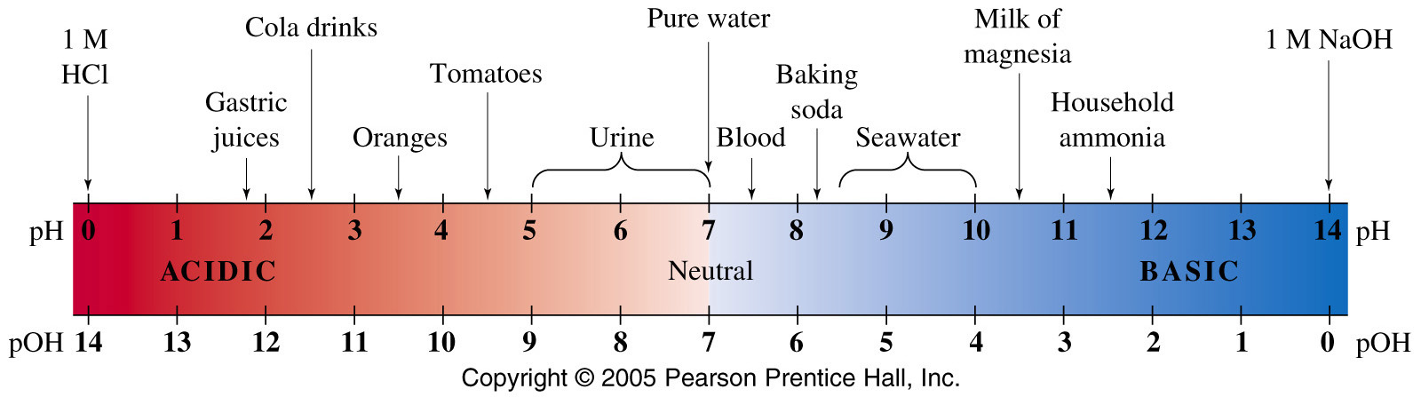
pH and pOH
pH is a measure of the strength of an acid; low pH = stronger acid
pH = –log[H₃O⁺] and [H₃O⁺] = 10^{–pH}
pOH is a measure of the strength of a base; low pOH = stronger base
pOH = –log[OH–] and [OH–] = 10^{–pOH}

Slide 10
Acid–Base Equilibria
For equilibrium constant expressions, K_{a} is used to represent the acid ionization constant …
… and K_{b} is used to represent the base ionization constant
HA + H₂O H⁺ + A–
B + H₂O BH⁺ + OH–
EXTREMELY IMPORTANT!
Make sure you only put reversible arrows on weak acid conjugate pair reaction.

Slide 11

Acid–Base Strength (cont’d)
K_{a} values are used to compare the strengths of weak acids; ↑ K, ↑ strength
For strong acids, water has a leveling effect; that is, when the strong acids are dissolved in water, they all completely ionize to the hydronium ion

Slide 12
Ionisation Constant Relationships
pK_{w} is the negative logarithm of K_{w} and at 25 ºC is equal to 14.00
pK_{w} = pH + pOH = 14.00
K_{w} = [H⁺][OH–] = 1 × 10^{–14}
For conjugate acid–base pairs …
K_{w} = (K_{a})(K_{b}) = 1 × 10^{–14}

Slide 13
Acid–Base Equilibrium Calculations
The “5% rule” says that, for these equilibrium calculations to work properly, the acid must not dissociate more than 5% in water

Slide 14
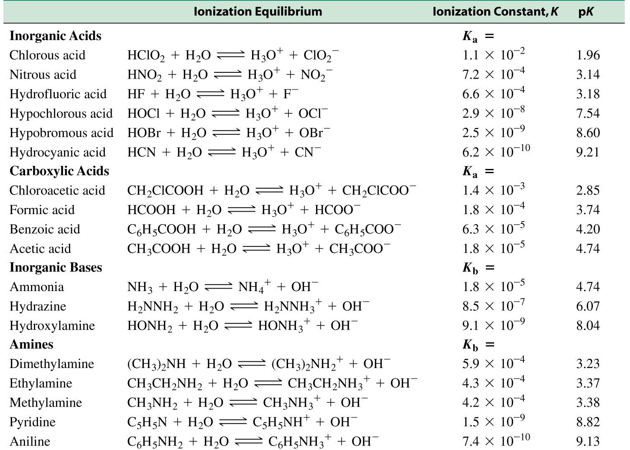
Some Ionization Constants

Slide 15
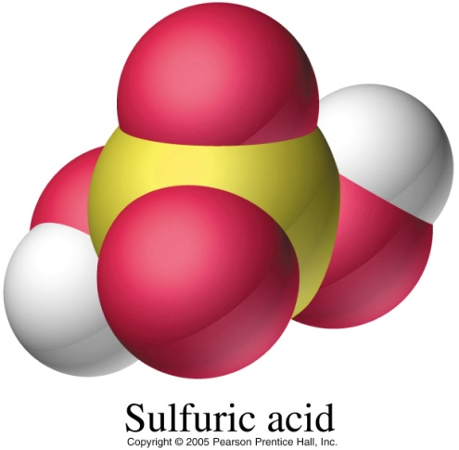
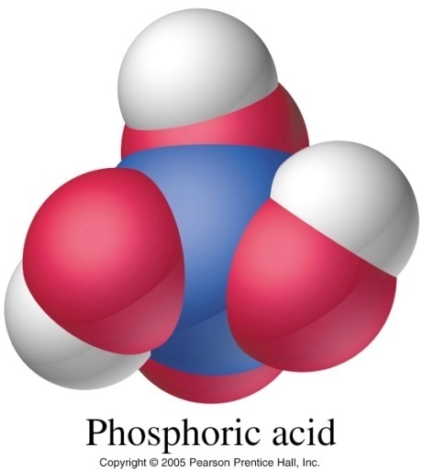
Polyprotic Acids
HNO₃ nitric acid – monoprotic
H₂SO₄ sulfuric acid - diprotic - 2 H⁺
H₃PO₄ phosphoric acid - triprotic - 3 H⁺
Having more than one ionisable hydrogen does not mean stronger!
A monoprotic acid has one ionisable H atom per molecule e.g., HCl, hydrochloric acid
A polyprotic acid has more than one ionisable H atom per molecule e.g., sulfuric acid, H₂SO₄
Phosphoric acid has three ionisable H atoms
→ H₃PO₄

Slide 16
Salts from Acids and Bases
Salts made from strong acids and strong bases form neutral solutions: e.g., NaCl
Salts made from weak acids and strong bases form basic solutions: e.g., NaF
Salts made from strong acids and weak bases form acidic solutions: e.g., NH₄Cl
Salts made from weak acids and weak bases form solutions that are acidic in some cases, neutral or basic in others

Slide 17
The Common Ion Effect
If one solution contains a weak acid and another contains that acid and its conjugate base as a second solute, the two solutions have different pH values
The conjugate base is referred to as a common ion because it is found in both the weak acid and the anion
The common ion effect is the suppression of the ionization of a weak acid or a weak base by the presence of a common ion from a strong electrolyte

Slide 18
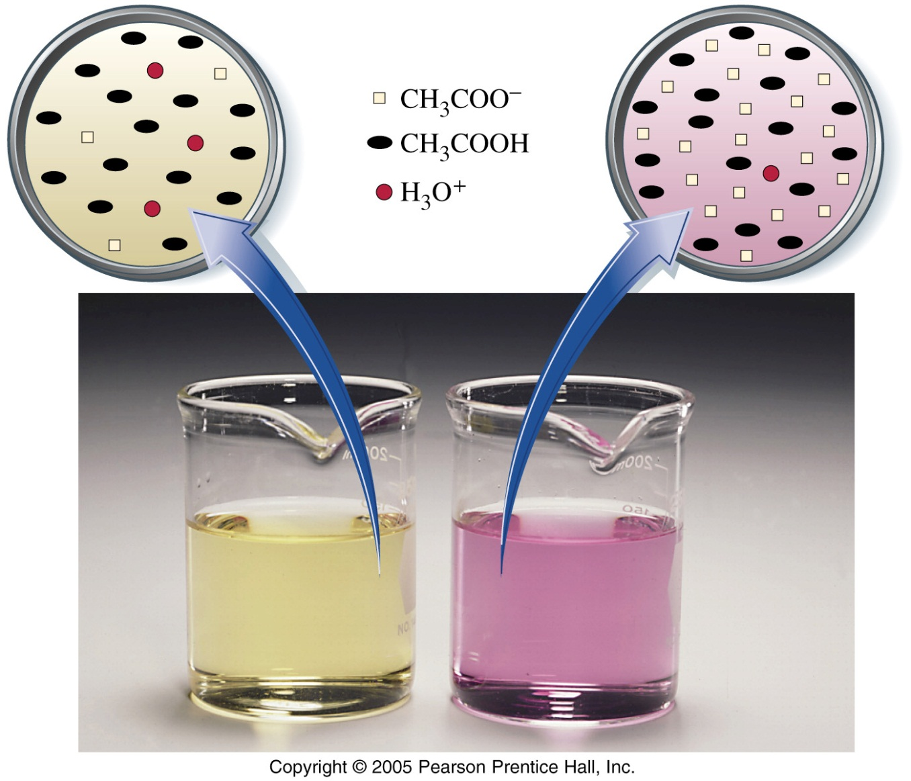
Common Ion Effect

Slide 19
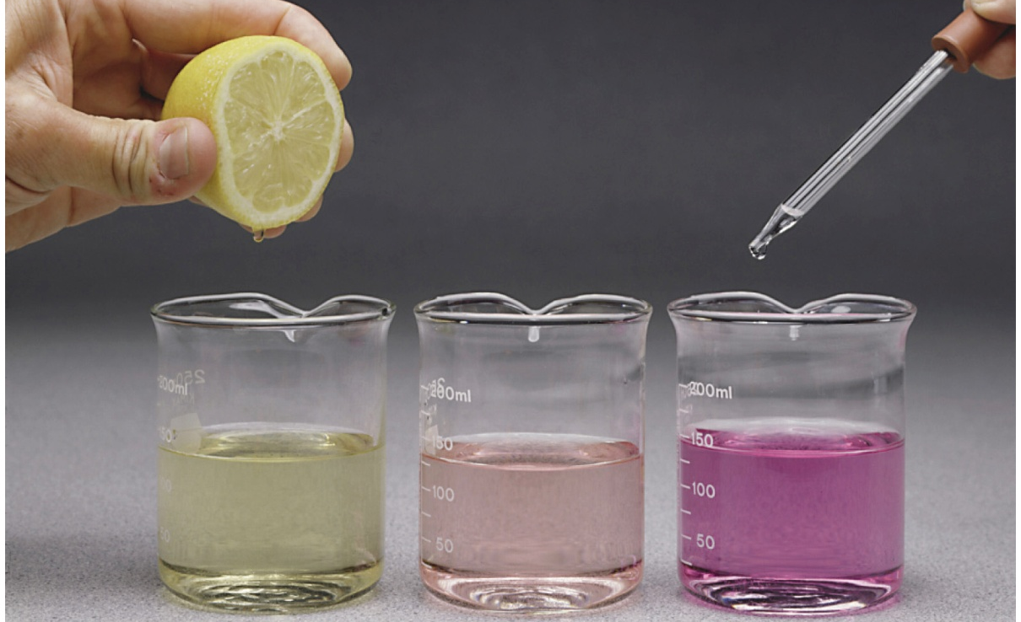
Acid–Base Indicators
An acid–base indicator is a weak acid having one color and the conjugate base of the acid having a different color. One of the “colours” may be colourless
Acid–base indicators are often used for applications in which precise pH readings aren’t necessary
EOS

Slide 20
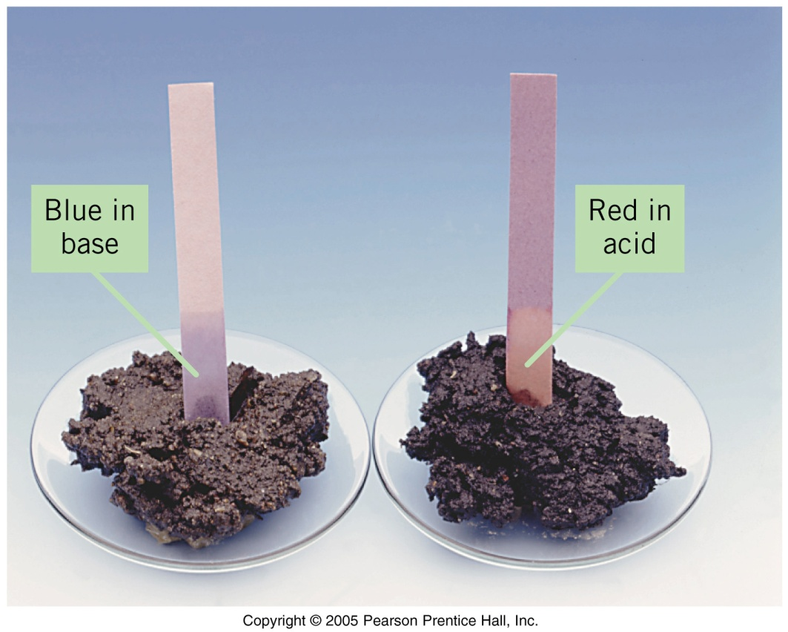
Acid–Base Indicators
A common indicator used in introductory chemistry laboratories is litmus
In an acidic solution, [H₃O⁺] is high. Because H₃O⁺ is a common ion, it suppresses the ionization of the indicator acid

Slide 21
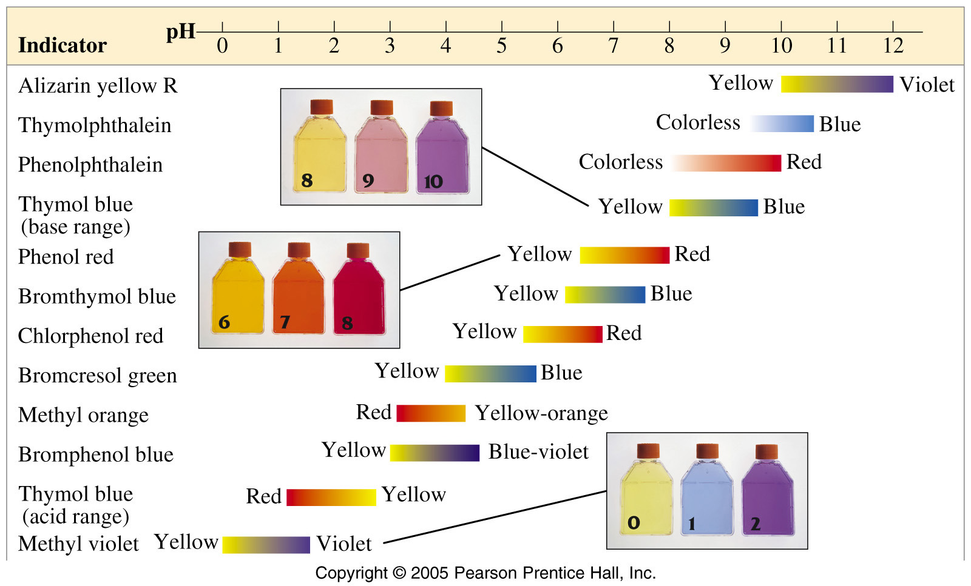
Common Indicators
Point of equivalence

Slide 22
Neutralisation Reactions
At the equivalence point in a titration, the acid and base have been brought together in exact stoichiometric proportions
mol acid = mol base
The indicator endpoint and the equivalence point for a neutralization reaction can be best matched by plotting a titration curve, a graph of pH versus volume of titrant

Slide 23
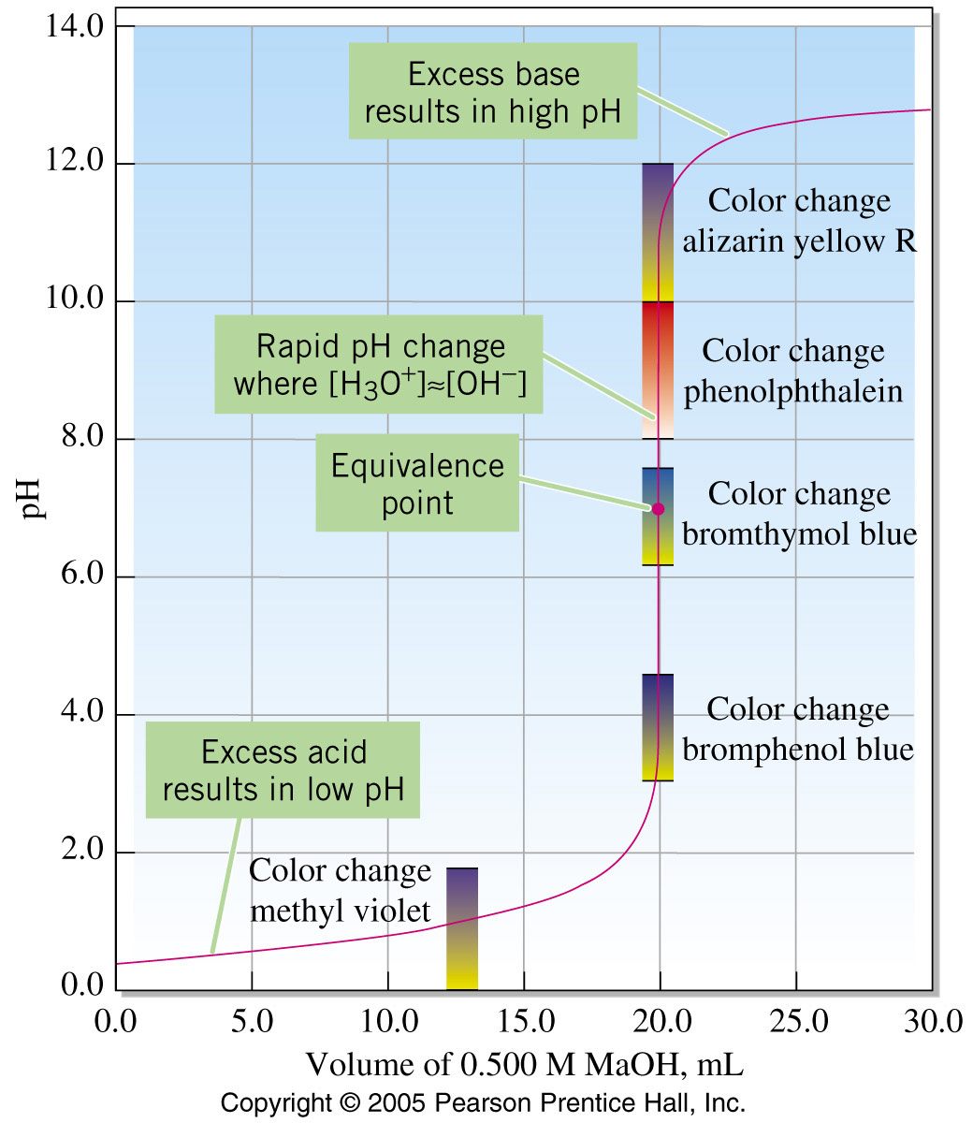
Titration Curves
The flat slopes are excess acid and base regions of solution
The steep slope is where complete neutralization occurs
Indicators work in different acidity ranges depending on molecular identity

Slide 24
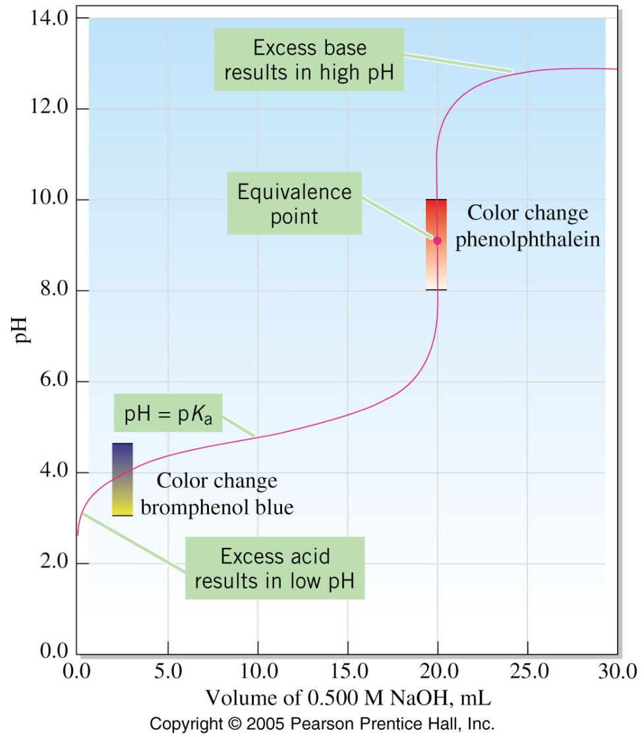
Titration Curve for Weak Acid–Strong Base
Similar features to strong acid/base curve
Buffering occurs in this system … therefore the Henderson–Hasselbalch equation applies in this region

Slide 25
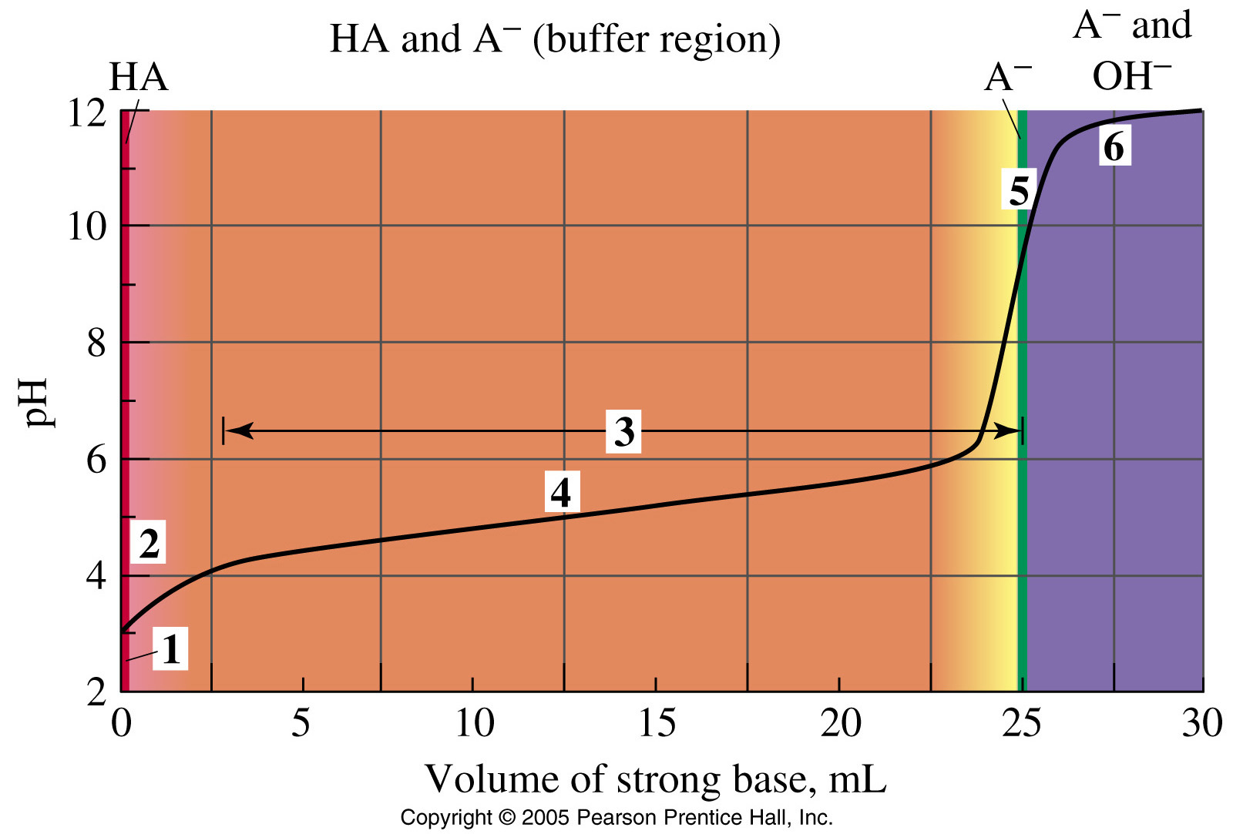
Titration Curve for Weak Acid–Strong Base

Slide 26
Summary
In the Brønsted–Lowry theory an acid is a proton donor and a base is a proton acceptor
If an acid is strong, its conjugate base is weak; and if a base is strong, its conjugate acid is weak
Water is amphiprotic: it can be either an acid or a base. It undergoes limited self-ionization producing H₃O⁺ and OH–
The pH in both pure water and in neutral solutions is 7. Acidic solutions have a pH less than 7 and basic solutions have a pH greater than 7

Slide 27
Summary (cont’d)
In aqueous solutions at 25 ºC, pH + pOH = 14.00
pH = –log[H₃O⁺] pOH = –log[OH–] pK_{w} = –logK_{w}
Hydrolysis reactions cause certain salt solutions to be either acidic or basic
A strong electrolyte that produces an ion common to the ionization equilibrium of a weak acid or a weak base suppresses the ionization of the weak electrolyte
Acid–base indicators are weak acids for which the acid and its conjugate base have different colors

